Slide 1

HC United group Cloud solution
CSA Monica Dodero

Slide 2






AGenda
Objectives
Assets
Planning
Governance
Q&A
Motivations and Business Outcomes
Current assets
Proposed Infrastructure Solution
Regulatory Compliance and Security
Follow up questions or doubts
Microsoft Azure

Slide 3

Objectives and concerns

Slide 4



Business outcomes
Compliance Regulations
Fast approach and respond
Scaling
Be compliant on the different standards like HIPAA, GDPR and ISO 27001
Successful auditing for the HIIPA compliance check.
Fast performance
Efficient response from everywhere in the planet
Future expansion of the business

Slide 5

Concerns
Complexity of migrating to the cloud
Exposing the infrastructure to the internet
Management complexity by global Tech-Ops department
Some sensitive medical records cannot be stored outside of Colombia
GDPR compliance and HIIPA auditing

Slide 6
Assets

Slide 7

Assets transformation
Microsoft 365
Azure AD

Slide 8

Assets transformation
Dynamics 365
Azure AD

Slide 9
Assets transformation

Slide 10
Assets transformation
Always On
Availability Sets

Slide 11
Assets transformation
Virtual WAN
SD-WAN Controller

Slide 12
Planning

Slide 13
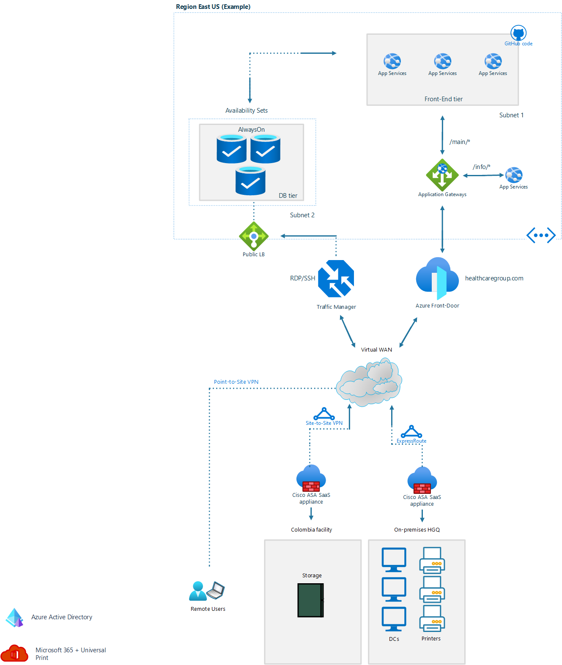
Proposed solution architecture

Slide 14
Governance

Slide 15




Governance
Azure Advisor
Azure Sentinel
Azure Monitor
Environment Recommendations

Slide 16
Q&A
Any question or doubt?

Slide 17

Thank you
Monica Dodero
Cloud Solutions Architect
mndodero@dummyms.com
+506 4845 1045

